Slide 1

Individual-based models & Spatially explicit individual-based models with NetLogoR
21-22 Juin 2021
Sarah Bauduin - Chargée de recherche à l’OFB
Équipe Loup-Lynx, Unité Prédateurs Animaux Déprédateurs et Exotiques

Slide 2
NetLogoR

Slide 3


What is NetLogoR?
NetLogo on R
« NetLogo is a multi-agent programmable modeling environment.»
R package to create and run IBMs on R
Translation of NetLogo, does not call the software!
Bauduin et al., 2019
Wilensky, 1999

Slide 4
Why NetLogoR?
Benefits from NetLogo
Efficient framework
Easy and fast learning
Benefits to be on R
Reduce mental switching cost between software to later analyze results on R
Can use multiple classes
Access to lots of packages and functions
Bauduin et al., 2019
Wilensky, 1999

Slide 5

NetLogoR
Available on CRAN
Published in Ecography

Slide 6
Let’s start coding some IBM

Slide 7
Forest model
Create a forest with trees
Trees grow
Some trees are cut

Slide 8
Forest model - exercise
Create a forest representing 100 plots
w1 <- createWorld(minPxcor = 0, maxPxcor = 9, minPycor = 0, maxPycor = 9)
w1 <- createWorld(minPxcor = 0, maxPxcor = 1, minPycor = 0, maxPycor = 49)
w1 <- createWorld(minPxcor = 1, maxPxcor = 4, minPycor = 0, maxPycor = 24)
w1 <- NLset(world = w1, agents = patches(w1), val = sample(x = 1:10, size = 100, replace = TRUE))
Trees grow by doubling their age
newAgeTrees <- ageTrees + ageTrees
newAgeTrees <- ageTrees * 2
Cut the first 5 trees
cutTrees <- patches(w1)[1:5,]

Slide 9
Population model
Create a population of turtles
Move the turtles around
Turtles age
Some reproduce
Some die

Slide 10
Population model - exercise
Create a population of 10 turtles facing north
t1 <- createTurtles(n = 10, world = w1, heading = 0)
Move the turtles : 0.1 step forward in a random direction between 10º to the left and 10º to the right
t1 <- right(turtles = t1, angle = runif(n = NLcount(t1), min = 0, max = 10))
t1 <- left(turtles = t1, angle = runif(n = NLcount(t1), min = 0, max = 10))
t1 <- right(turtles = t1, angle = runif(n = NLcount(t1), min = -10, max = 10))
t1 <- fd(turtles = t1, dist = 0.1, world = w1, torus = TRUE)
Turtles’ initial ages are between 1 and 8
t1 <- turtlesOwn(turtles = t1, tVar = "age", tVal = sample(x = 1:8, size = 10, replace = TRUE))

Slide 11
Population model - exercise
Turtles have “dominant” and “subordinate” status. There are 2 dominant females among the 5, and 3 dominant males among the 5. Only the dominant females reproduce and produce 2 offspring
t1 <- turtlesOwn(turtles = t1, tVar = "sex", tVal = c(rep("male", 5), rep("female", 5)))
t1 <- turtlesOwn(turtles = t1, tVar = "status", tVal = c(rep("dom", 3), rep("sub", 2), rep("dom", 2), rep("sub", 3)))
females <- NLwith(agents = t1, var = "sex", val = "female")
femalesDom <- NLwith(agents = females, var = "status", val = "dom")
dom <- NLwith(agents = t1, var = "status", val = "dom")
femalesDom <- NLwith(agents = dom, var = "sex", val = "female")
t1 <- hatch(turtles = t1, who = of(agents = femalesDom, var = "who"), n = 2, breed = "offspring")
t1 <- NLset(turtles = t1, agents = NLwith(agents = t1, var = "breed", val = "offspring"), var = c("age", "sex", "status"), val = cbind.data.frame(age = rep(0, 4), sex = sample(c("male", "female"), size = 4, replace = TRUE), status = rep("sub", 4)))

Slide 12
NetLogoR in details

Slide 13
NetLogoR
Provides classes
Landscape with coordinate system similar to NetLogo
Landsace cells = « patches »
New R class of mobile agents = « turtles »
agentMatrix
Faster version of SpatialPointsDataFrame
And functions (« primitives » NetLogo)
Movement
Landscape/individual interactions
Population dynamics
…
No implementation of « links »
No implementation of the visual interface
Graphics possible with regular R functions

Slide 14
Main steps to build a model with NetLogoR
library(NetLogoR)
Create the world in which the agents will evolve with the function createWorld()
Define and assign values to the patches when creating the world createWorld(..., data = ...) or after using the function NLset(). You can visualize the world with plot(nameWorld).
Create the turtles (i.e., moving agents) with the function createTurtles(). You can visualize the turtles by plotting them on the world with points(nameTurtles, pch = 16).
Create the different procedures (i.e., functions affecting the agents) by using the NetLogoR functions, the R functions or some from other packages.
It is useful to test the different procedures individually with a small world and a few numbers of turtles to make sure the code is doing what you want it to do.
Then, build the main procedure for the model. A for-loop or a scheduler function can be used to manage time. The functions placed inside the for-loop or the scheduler function will be iterated the number of time steps defined.
Visualizations can be plotted at each time step and/or at the end when the iterations are over. Remember that plot functions take time to be executed and can slow down the model.

Slide 15
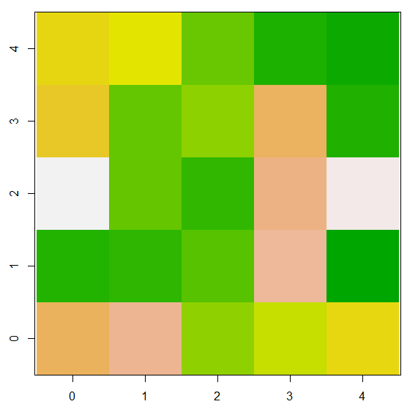
R classes for the landscape: worldMatrix and worldArray
A worldMatrix object can be viewed as a grid composed of squared patches (i.e., cells), a 2-dimensional landscape.
Patches have two spatial coordinates pxcor and pycor, representing the location of their center.
pxcor and pycor are always integer and increment by 1. pxcor increases as you move right and pycor increases as you move up.
pxcor and pycor can be negative if there are patches to the left or below the patch[0,0].
worldMatrix do not have coordinate systems.
worldMatrix can be viewed as a mix between matrix and RasterLayer

Slide 16
R classes for the landscape: worldMatrix and worldArray
This is an extension of matrix with 7 additional slots.
> w1@minPxcor
[1] 0
> w1@maxPxcor
[1] 4
> w1@minPycor
[1] 0
> w1@maxPycor
[1] 4
> w1@extent
class : Extent
xmin : -0.5
xmax : 4.5
ymin : -0.5
ymax : 4.5
> w1@res
[1] 1 1

Slide 17
R classes for the landscape: worldMatrix and worldArray
> w1@pCoords
pxcor pycor
[1,] 0 4
[2,] 1 4
[3,] 2 4
[4,] 3 4
[5,] 4 4
[6,] 0 3
[7,] 1 3
[8,] 2 3
[9,] 3 3
[10,] 4 3
[11,] 0 2
[12,] 1 2
[13,] 2 2
[14,] 3 2
[15,] 4 2
[16,] 0 1
[17,] 1 1
[18,] 2 1
[19,] 3 1
[20,] 4 1
[21,] 0 0
[22,] 1 0
[23,] 2 0
[24,] 3 0
[25,] 4 0

Slide 18
R classes for the landscape: worldMatrix and worldArray
> w1@.Data
[,1] [,2] [,3] [,4] [,5]
[1,] 0.4763950 0.5136438 0.7306483 0.9009050 0.94322540
[2,] 0.4332253 0.7447880 0.6628346 0.3194291 0.89201067
[3,] 0.0410270 0.7383873 0.8514184 0.2501377 0.05842418
[4,] 0.8851923 0.8573701 0.7687598 0.2047619 0.97493443
[5,] 0.3244368 0.2263357 0.6574082 0.5615647 0.47929185
The methods [] and [] <- retrieve or assign values for the patches in the given order of the patches coordinates provided. When no patches coordinates are provided, the values retrieved or assigned is done in the order of the cell numbers as defined in in Raster* objects (i.e., by rows).

Slide 19
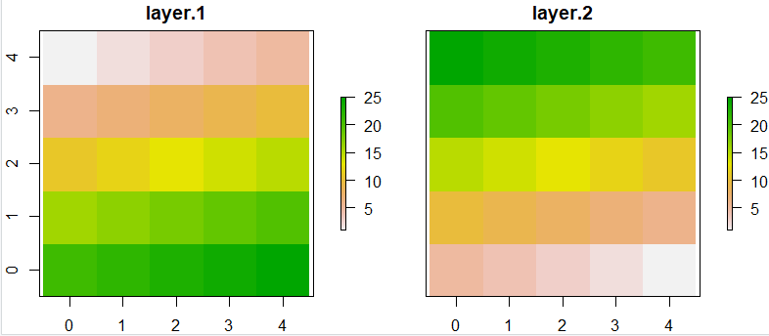
R classes for the landscape: worldMatrix and worldArray
The worldArray class is a collection of several worldMatrix objects with the same extent stacked together. It is used to keep more than one value per patch.
worldArray can be viewed as a mix between array and RasterStack.
> w1 <- createWorld(minPxcor = 0, maxPxcor = 4, minPycor = 0, maxPycor = 4, data = 1:25)
> w2 <- createWorld(minPxcor = 0, maxPxcor = 4, minPycor = 0, maxPycor = 4, data = 25:1)
> w3 <- stackWorlds(w1, w2)
> plot(w3)
> w3@.Data
, , w1
[,1] [,2] [,3] [,4] [,5]
[1,] 1 2 3 4 5
[2,] 6 7 8 9 10
[3,] 11 12 13 14 15
[4,] 16 17 18 19 20
[5,] 21 22 23 24 25
, , w2
[,1] [,2] [,3] [,4] [,5]
[1,] 25 24 23 22 21
[2,] 20 19 18 17 16
[3,] 15 14 13 12 11
[4,] 10 9 8 7 6
[5,] 5 4 3 2 1

Slide 20
R classes for the landscape: worldMatrix and worldArray
By default the world is bounded (not « wrapped »). But you can make the world a torus so that when a turtle moves past the edge of the world, it disappears and reappears on the opposite edge. This option is an argument in some functions.
plot(nameWorld) works with both worldMatrix and worldArray. To visualize only one layer of a worldArray, use plot(nameWorldArray[[layerNumber]]) or plot(nameWorldArray[["layerName"]]).

Slide 21
R classes for the landscape: worldMatrix and worldArray - exercise
Create a 3-layer world of 15 patches
The 1st layer where all patches are equal to 12
The 2nd layer where patches are either 1 or 2, randomly
The 3rd layer where patches are equal to their pxcor
Plot the 3 layers
Plot only the 2nd layer

Slide 22
R classes for the landscape: worldMatrix and worldArray - exercise
Create a 3-layer world of 15 patches
The 1st layer where all patches are equal to 12
w1 <- createWorld(minPxcor = 1, maxPxcor = 3, minPycor = 1, maxPycor = 5, data = 12)
The 2nd layer where patches are either 1 or 2, randomly
w2 <- createWorld(minPxcor = 1, maxPxcor = 3, minPycor = 1, maxPycor = 5, data = sample(x = c(1,2), size = 15, replace = TRUE))
The 3rd layer where patches are equal to their pxcor
w3 <- createWorld(minPxcor = 1, maxPxcor = 3, minPycor = 1, maxPycor = 5, data = patches(w1)[, "pxcor"])
wAll <- stackWorlds(w1, w2, w3)
Plot the 3 layers
plot(wAll)
Plot only the 2nd layer
plot(wAll[[2]])
plot(wAll[["w2"]])

Slide 23
R class for the mobile agents: agentMatrix
AgentMatrix is an object of length n (nrows = number of turtles) with data for the turtles being: xcor, ycor, who, heading, prevX, prevY, breed, and color by default.
“Turtles” are the moving agents.
Turtles exist in a worldMatrix.
> t1 <- createTurtles(n = 10, coords = randomXYcor(w1, n = 10))
> t1
who heading prevX prevY breed color
1 0 2.644112 NA NA turtle #FF0000FF
2 1 320.563929 NA NA turtle #FF9900FF
3 2 192.412396 NA NA turtle #CCFF00FF
4 3 155.435898 NA NA turtle #33FF00FF
5 4 167.149854 NA NA turtle #00FF66FF
6 5 68.437296 NA NA turtle #00FFFFFF
7 6 170.062184 NA NA turtle #0066FFFF
8 7 155.778326 NA NA turtle #3300FFFF
9 8 5.429264 NA NA turtle #CC00FFFF
10 9 57.866792 NA NA turtle #FF0099FF

Slide 24
R class for the mobile agents: agentMatrix
> t1
who heading prevX prevY breed color
1 0 2.644112 NA NA turtle #FF0000FF
2 1 320.563929 NA NA turtle #FF9900FF
3 2 192.412396 NA NA turtle #CCFF00FF
4 3 155.435898 NA NA turtle #33FF00FF
5 4 167.149854 NA NA turtle #00FF66FF
6 5 68.437296 NA NA turtle #00FFFFFF
7 6 170.062184 NA NA turtle #0066FFFF
8 7 155.778326 NA NA turtle #3300FFFF
9 8 5.429264 NA NA turtle #CC00FFFF
10 9 57.866792 NA NA turtle #FF0099FF
> t1@.Data
xcor ycor who heading prevX prevY breed color
[1,] -0.45613 2.85397 0 66.29879 NA NA 1 8
[2,] 0.69175 2.08783 1 337.10566 NA NA 1 10
[3,] 3.45043 4.40191 2 311.12937 NA NA 1 7
[4,] -0.40015 1.61013 3 278.62921 NA NA 1 5
[5,] 2.89419 2.87709 4 321.40054 NA NA 1 2
[6,] 2.82283 2.91621 5 85.45662 NA NA 1 3
[7,] -0.03122 0.35232 6 87.58605 NA NA 1 1
[8,] 1.26644 1.83430 7 169.65826 NA NA 1 4
[9,] 2.79047 2.77146 8 177.33894 NA NA 1 6
[10,] 3.30077 2.63409 9 353.81830 NA NA 1 9

Slide 25
R class for the mobile agents: agentMatrix
New “characteristics” can be added to the turtles.
> t1 <- turtlesOwn(turtles = t1, tVar = "sex",
tVal = c("F", "F", "F","F", "F", "F", "M", "M","M", "M"))
> t1
who heading prevX prevY breed color sex
1 0 2.644112 NA NA turtle #FF0000FF F
2 1 320.563929 NA NA turtle #FF9900FF F
3 2 192.412396 NA NA turtle #CCFF00FF F
4 3 155.435898 NA NA turtle #33FF00FF F
5 4 167.149854 NA NA turtle #00FF66FF F
6 5 68.437296 NA NA turtle #00FFFFFF F
7 6 170.062184 NA NA turtle #0066FFFF M
8 7 155.778326 NA NA turtle #3300FFFF M
9 8 5.429264 NA NA turtle #CC00FFFF M
10 9 57.866792 NA NA turtle #FF0099FF M

Slide 26
R class for the mobile agents: agentMatrix - exercise
Create a population of 10 individuals, all at the location [0;0] with their heading either North or South, randomly
Give them all an age of 5
Give them a sex “male” or “female” randomly

Slide 27
R class for the mobile agents: agentMatrix - exercise
Create a population of 10 individuals, all at the location [0;0] with their heading either North or South, randomly
t1 <- createTurtles(n = 10, coords = cbind(pxcor = rep(0, 10), pycor = rep(0, 10)), heading = sample(c(0, 180), size = 10, replace = TRUE))
t1@.Data
Give them all an age of 5
t1 <- turtlesOwn(turtles = t1, tVar = "age", tVal = 3)
t1 <- turtlesOwn(turtles = t1, tVar = "age", tVal = rep(3, 10))
Give them a sex “male” or “female” randomly
t1 <- turtlesOwn(turtles = t1, tVar = "sex", tVal = sample(x = c("male", "female"), size = 10, replace = TRUE))

Slide 28
Agents: turtles or patches
Turtles are moving agents. Turtles are represented with an agentMatrix.
Patches are non-moving agents. Patches are cells of a world. Patches are represented with a 2-column matrix with pxcor and pycor columns (i.e., coordinates of their center).
Turtles coordinates can have decimals (i.e., can be anywhere on the patches). Patches coordinates are always integer.

Slide 29
Agentset
An “agentset” is a set of agents.
Agentsets contain only some patches or some turtles. An agentset cannot contain the two agent types (patches and turtles) at once.
A patch agentset is a matrix that contains patches coordinates; a turtle agentset is an agentMatrix object containing turtles.
Agentsets can then be passed on as arguments in functions. Agentsets can be redefined at any time.
For turtles, agents and agentset are the same.

Slide 30
Agentset for turtles
Create 5 sheep and 5 wolves
> t2 <- createTurtles(world = w1, n = 10, breed = c(rep("sheep", 5),
rep("wolf", 5)))
> sheep <- NLwith(agents = t2, var = "breed", val = "sheep")
> wolves <- NLwith(agents = t2, var = "breed", val = "wolf")
> sheep <- createTurtles(world = w1, n = 5, breed = "sheep")
> wolves <- createTurtles(world = w1, n = 5, breed = "wolf")

Slide 31
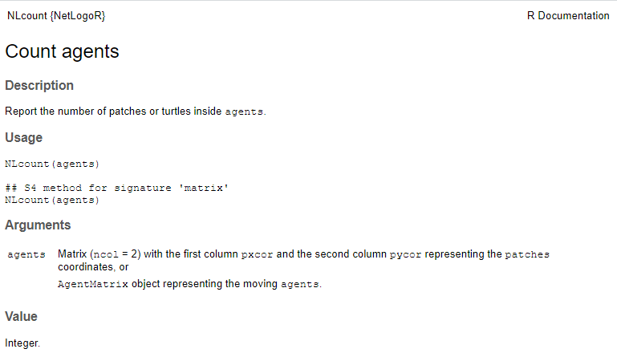
Functions
NetLogoR functions can act (modify or use) worlds (worldMatrix, worldArray), patches (2-column matrix) and/or turtles (agentMatrix).

Slide 32
Functions
Function name | Description | Topic
bk | Move backward | Movement
canMove | Can the turtles move? | Movement
cellFromPxcorPycor | Cells numbers from patches coordinates
clearPatches | Clear world’s patches
createOTurtles | Create ordered turtles | Population dynamics
createTurtles | Create turtles | Population dynamics
createWorld | Create a world
die | Kill turtles | Population dynamics
diffuse | Diffuse values in a world
downhill | Move downhill | Movement
dx | x-increment
dy | y-increment
face | Face something | Movement
fd | Move forward | Movement
hatch | Hatch new turtles | Population dynamics

Slide 33
Functions
Function name | Description | Topic
home | Return home | Movement
inCone | Agents in cone | Selection
inRadius | Agents in radius | Selection
inspect | Inspect turtles
isNLclass | Type of object
layoutCircle | Layout turtles on a circle | Movement
left | Rotate to the left | Movement
maxNof | N agents with maximum | Selection
maxOneOf | One agent with maximum | Selection
maxPxcor | Maximum pxcor
maxPycor | Maximum pycor
minNof | N agents with minimum | Selection
minOneOf | One agent with minimum | Selection
minPxcor | Minimum pxcor
minPycor | Minimum pycor

Slide 34
Functions
Function name | Description | Topic
moveTo | Move to | Movement
neighbors | Neighbors patches | Selection
NLall | All agents?
NLany | Any agents?
NLcount | Count agents
NLdist | Distances between agents
NLset | Set an agents variable
NLwith | Agents with | Selection
NLworldIndex | WorldMatrix indices from vector indices
nOf | N random agents | Selection
noPatches | No patches
noTurtles | No turtles
of | Values of an agents variable
oneOf | One random agent | Selection
other | Others | Selection

Slide 35
Functions
Function name | Description | Topic
patch | Patches coordinates
patchAhead | Patches ahead | Selection
patchAt | Patches at | Selection
patchDistDir | Patches at given distances and directions | Selection
patches | All the patches in a world | Selection
patchHere | Patches here | Selection
patchLeft | Patches on the left | Selection
patchRight | Patches on the right | Selection
patchSet | Patch set
pExist | Do the patches exist?
PxcorPycorFromCell | Patches coordinates from cells numbers
randomPxcor | Random pxcor
randomPycor | Random pycor
randomXcor | Random xcor
randomXYcor | Random turtles coordinates

Slide 36
Functions
Function name | Description | Topic
randomYcor | Random ycor
raster2world | Convert a Raster* object into a worldMatrix or worldArray object
right | Rotate to the right | Movement
setXY | Set turtles’ locations | Movement
sortOn | Sort agents
spdf2turtles | From SpatialPointsDataFrame to agentMatrix
sprout | Sprout new turtles | Population dynamics
stackWorlds | Stack worlds
subHeadings | Subtract headings
tExist | Do the turtle exist?
towards | Directions towards | Movement
turtle | Select turtles | Selection
turtles2spdf | From agentMatrix to SpatialPointsDataFrame
turtlesAt | Turtles at | Selection
turtleSet | Create a turtle agentset | Selection

Slide 37
Functions
Function name | Description | Topic
turtlesOn | Turtles on | Selection
turtlesOwn | New turtles variable
uphill | Move uphill | Movement
withMax | Agents with maximum | Selection
withMin | Agents with minimum | Selection
world2raster | Convert a worldMatrix or worldArray object into a Raster* object
worldHeight | World height
worldWidth | World width

Slide 38
NetLogoR
Ressources
Beginner guide
Dictionnary NetLogo <=> NetLogoR
3 model examples
Butterfly Hilltopping
Ants
Wolf Sheep Predation

Slide 39

Butterfly hilltopping
Repeat
Butterflies
Habitat
MOVEMENT
Railsback and Grimm, 2012

Slide 40
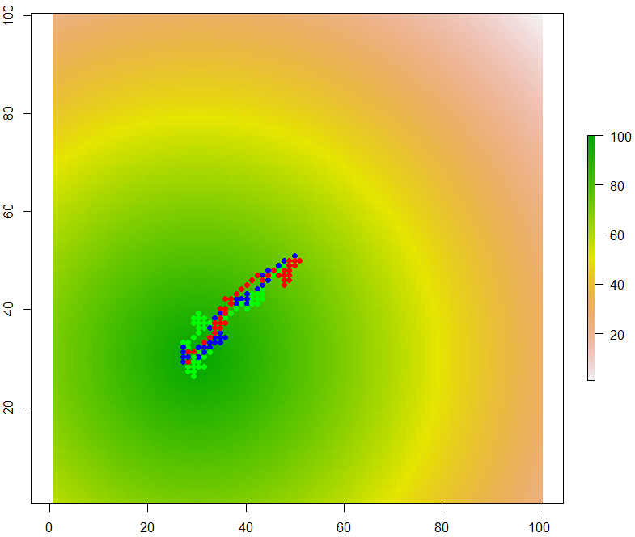
Butterfly hilltopping = IBM
MOVEMENT
Rules at the individual level
Emergence of patterns at the population level
E.g., migration route
Railsback and Grimm, 2012

Slide 41
Butterfly hilltopping = SE-IBM
Influence of the environment in the individual’s decisions
Repeat
Butterflies
Habitat
MOVEMENT
Railsback and Grimm, 2012

Slide 42
Butterfly hilltopping
A butterfly moving uphill on a gridded landscape with a hill, one cell at the time
p = 0.5, move uphill
move to their neighboring cell with the highest elevation value
p = 0.5, move randomly
move to one of their neighboring cells without preference
Railsback and Grimm, 2012

Slide 43
Butterfly hilltopping
MOVEMENT
Fly up
p = 0.5
Fly randomly
p = 0.5
Railsback and Grimm, 2012

Slide 44
Butterfly hilltopping
MOVEMENT
Fly up
p = 0.5
Habitat
Railsback and Grimm, 2012

Slide 45
Butterfly hilltopping
MOVEMENT
Fly randomly
p = 0.5
1/8
1/8
1/8
1/8
1/8
1/8
1/8
1/8
Railsback and Grimm, 2012

Slide 46
Butterfly hilltopping
MOVEMENT
Repeat for each individual
At each time step
Fly up
p = 0.5
Fly randomly
p = 0.5
1/8
1/8
1/8
Habitat
1/8
1/8
1/8
1/8
1/8
Railsback and Grimm, 2012

Slide 47
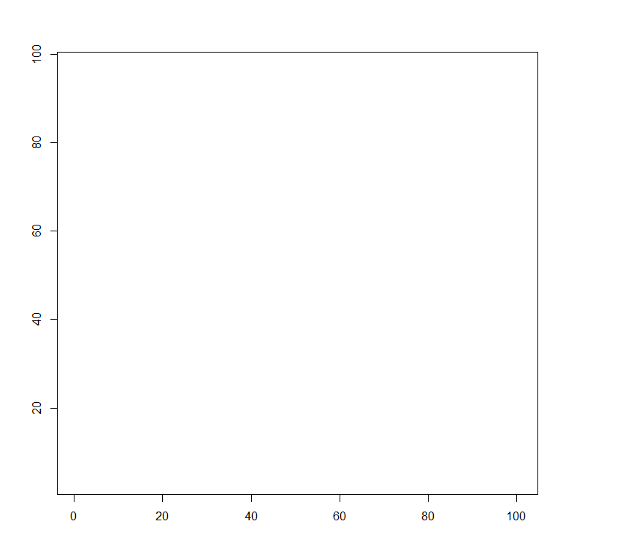
hill <- createWorld(minPxcor = 1, maxPxcor = 100, minPycor = 1, maxPycor = 100)
elevation <- 100 - NLdist(agents = patches(hill),
agents2 = cbind(x = 30, y = 30))
hill <- NLset(world = hill, agents = patches(hill), val = elevation)
plot(hill)
b3 <- createTurtles(n = 3, coords = cbind(xcor = 50, ycor = 50))
points(b3, pch = 16, col = of(agents = b3, var = "color"))
for (time in 1:100) {
if (runif(n = 1, min = 0, max = 1) < 0.5) {
b3 <- uphill(world = hill, turtles = b3, nNeighbors = 8)
} else {
allNeighbors <- neighbors(world = hill, agents = b3, nNeighbors = 8)
oneNeighbor <- oneOf(allNeighbors)
b3 <- moveTo(turtles = b3,
agents = oneNeighbor)
}
points(b3, pch = 16,
col = of(agents = b3,
var = "color"))
}

Slide 48
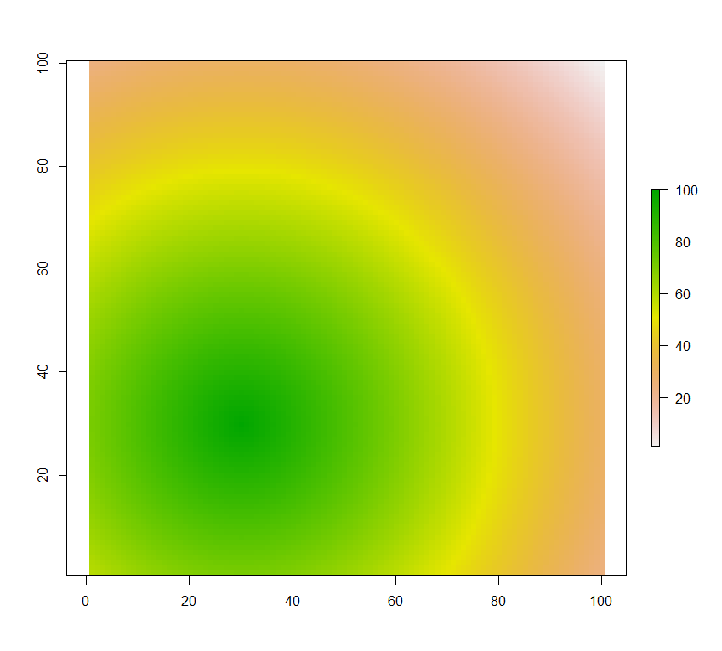
hill <- createWorld(minPxcor = 1, maxPxcor = 100, minPycor = 1, maxPycor = 100)
elevation <- 100 - NLdist(agents = patches(hill), agents2 = cbind(x = 30, y = 30))
hill <- NLset(world = hill, agents = patches(hill), val = elevation)
plot(hill)
b3 <- createTurtles(n = 3, coords = cbind(xcor = 50, ycor = 50))
points(b3, pch = 16, col = of(agents = b3, var = "color"))
for (time in 1:100) {
if (runif(n = 1, min = 0, max = 1) < 0.5) {
b3 <- uphill(world = hill, turtles = b3, nNeighbors = 8)
} else {
allNeighbors <- neighbors(world = hill, agents = b3, nNeighbors = 8)
oneNeighbor <- oneOf(allNeighbors)
b3 <- moveTo(turtles = b3,
agents = oneNeighbor)
}
points(b3, pch = 16,
col = of(agents = b3,
var = "color"))
}

Slide 49

hill <- createWorld(minPxcor = 1, maxPxcor = 100, minPycor = 1, maxPycor = 100)
elevation <- 100 - NLdist(agents = patches(hill), agents2 = cbind(x = 30, y = 30))
hill <- NLset(world = hill, agents = patches(hill), val = elevation)
plot(hill)
b3 <- createTurtles(n = 3, coords = cbind(xcor = 50, ycor = 50))
points(b3, pch = 16, col = of(agents = b3, var = "color"))
for (time in 1:100) {
if (runif(n = 1, min = 0, max = 1) < 0.5) {
b3 <- uphill(world = hill, turtles = b3, nNeighbors = 8)
} else {
allNeighbors <- neighbors(world = hill, agents = b3, nNeighbors = 8)
oneNeighbor <- oneOf(allNeighbors)
b3 <- moveTo(turtles = b3,
agents = oneNeighbor)
}
points(b3, pch = 16,
col = of(agents = b3,
var = "color"))
}

Slide 50
hill <- createWorld(minPxcor = 1, maxPxcor = 100, minPycor = 1, maxPycor = 100)
elevation <- 100 - NLdist(agents = patches(hill), agents2 = cbind(x = 30, y = 30))
hill <- NLset(world = hill, agents = patches(hill), val = elevation)
plot(hill)
b3 <- createTurtles(n = 3, coords = cbind(xcor = 50, ycor = 50))
points(b3, pch = 16, col = of(agents = b3, var = "color"))
for (time in 1:100) {
if (runif(n = 1, min = 0, max = 1) < 0.5) {
b3 <- uphill(world = hill, turtles = b3, nNeighbors = 8)
} else {
allNeighbors <- neighbors(world = hill, agents = b3, nNeighbors = 8)
oneNeighbor <- oneOf(allNeighbors)
b3 <- moveTo(turtles = b3, agents = oneNeighbor)
}
points(b3, pch = 16, col = of(agents = b3, var = "color"))
}

Slide 51
hill <- createWorld(minPxcor = 1, maxPxcor = 100, minPycor = 1, maxPycor = 100)
elevation <- 100 - NLdist(agents = patches(hill), agents2 = cbind(x = 30, y = 30))
hill <- NLset(world = hill, agents = patches(hill), val = elevation)
plot(hill)
b3 <- createTurtles(n = 3, coords = cbind(xcor = 50, ycor = 50))
points(b3, pch = 16, col = of(agents = b3, var = "color"))
for (time in 1:100) {
if (runif(n = 1, min = 0, max = 1) < 0.5) {
b3 <- uphill(world = hill, turtles = b3, nNeighbors = 8)
} else {
allNeighbors <- neighbors(world = hill, agents = b3, nNeighbors = 8)
oneNeighbor <- oneOf(allNeighbors)
b3 <- moveTo(turtles = b3, agents = oneNeighbor)
}
points(b3, pch = 16, col = of(agents = b3, var = "color"))
}

Slide 52
hill <- createWorld(minPxcor = 1, maxPxcor = 100, minPycor = 1, maxPycor = 100)
elevation <- 100 - NLdist(agents = patches(hill), agents2 = cbind(x = 30, y = 30))
hill <- NLset(world = hill, agents = patches(hill), val = elevation)
plot(hill)
b3 <- createTurtles(n = 3, coords = cbind(xcor = 50, ycor = 50))
points(b3, pch = 16, col = of(agents = b3, var = "color"))
for (time in 1:100) {
if (runif(n = 1, min = 0, max = 1) < 0.5) {
b3 <- uphill(world = hill, turtles = b3, nNeighbors = 8)
} else {
allNeighbors <- neighbors(world = hill, agents = b3, nNeighbors = 8)
oneNeighbor <- oneOf(allNeighbors)
b3 <- moveTo(turtles = b3, agents = oneNeighbor)
}
points(b3, pch = 16, col = of(agents = b3, var = "color"))
}

Slide 53
hill <- createWorld(minPxcor = 1, maxPxcor = 100, minPycor = 1, maxPycor = 100)
elevation <- 100 - NLdist(agents = patches(hill), agents2 = cbind(x = 30, y = 30))
hill <- NLset(world = hill, agents = patches(hill), val = elevation)
plot(hill)
b3 <- createTurtles(n = 3, coords = cbind(xcor = 50, ycor = 50))
points(b3, pch = 16, col = of(agents = b3, var = "color"))
for (time in 1:100) {
if (runif(n = 1, min = 0, max = 1) < 0.5) {
b3 <- uphill(world = hill, turtles = b3, nNeighbors = 8)
} else {
allNeighbors <- neighbors(world = hill, agents = b3, nNeighbors = 8)
oneNeighbor <- oneOf(allNeighbors)
b3 <- moveTo(turtles = b3, agents = oneNeighbor)
}
points(b3, pch = 16, col = of(agents = b3, var = "color"))
}

Slide 54
Butterfly hilltopping - exercise
Create a population of 50 butterflies
b3 <- createTurtles(n = 50, coords = cbind(xcor = 50, ycor = 50))
Replace the 1st movement pattern by one where butterflies move up, selecting their neighboring patch with the highest elevation among the ones in their cone of vision of [-90º;90º]
patchesInFront <- inCone(turtles = b3, radius = 1, angle = 180, agents = patches(hill))
patchesInFrontElev <- as.data.frame(cbind(patchesInFront, elevation = of(agents = patchesInFront[, c(1, 2)], world = hill)))
library(dplyr)
patchesToMove <- patchesInFrontElev %>% group_by(id) %>% top_n(1, elevation)
b3 <- moveTo(turtles = b3, agents = as.matrix(patchesToMove[, c(1, 2)]))

Slide 55
Butterfly hilltopping - exercise
Add a mortality process at the end of each time step. Each butterfly has a 0.05 chance to die
mortalityProb <- 0.05
if (runif(n = 1, min = 0, max = 1) < 0.5) {
…
}
whoDie <- rbinom(n = NLcount(b3), size = 1, prob = mortalityProb)
b3 <- die(turtles = b3, who = of(agents = b3, var = "who")[which(whoDie == 1)])

Slide 56
NetLogoR A more complex model

Slide 57
Wolf Sheep Predation
Prey-predator system
2 types of moving individuals
Interactions individual/landscape and individual/individual

Slide 60
Wolf Sheep Predation
Prey-predator system
2 types of moving individuals
Interactions individual/landscape and individual/individual
Let’s look at the NetLogoR model for the code

Slide 61
References
NetLogoR
Bauduin S, McIntire EJB, Chubaty AM. 2019. NetLogoR: a package to build and run spatially explicit agent‐based models in R. Ecography 42:1841–1849.
NetLogo
Wilensky U. 1999. NetLogo. Center for Connected Learning and Computer-Based Modeling, Northwestern University, Evanston, IL. Available from http://ccl.northwestern.edu/netlogo/.

